Slide 1


IPL Analysis
Author: Angel Joy

Slide 2
Data Problem
RCB is looking for top-performing and reliable players to win tournaments, considering both on-field performance and value for money in mega player auction of 2017.
Key Objectives:
Analyze player past performances
Evaluate venue and toss decision impact on players
Identify top-performing players to win the tournaments

Slide 3
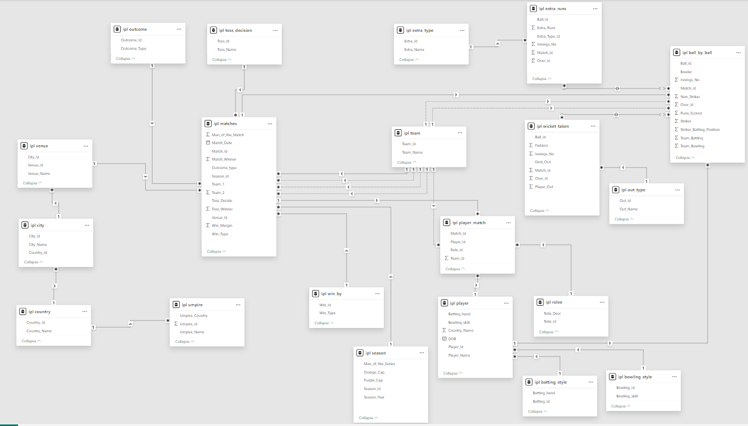
Database Schema

Slide 4
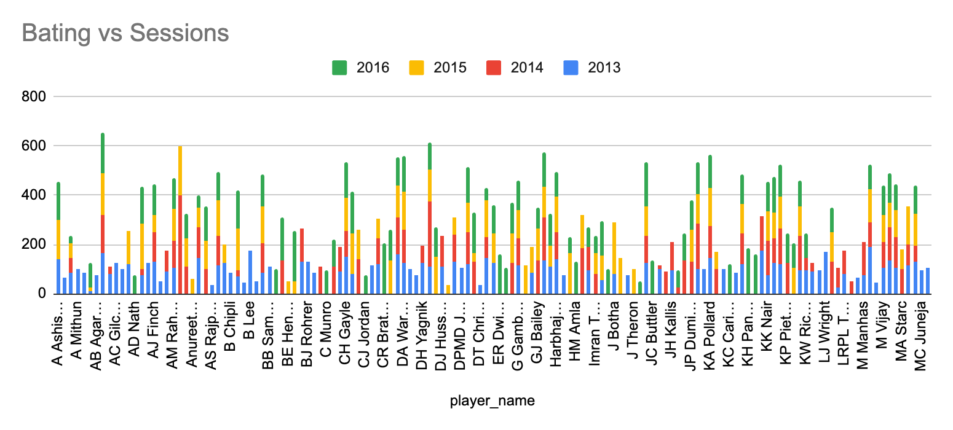
Player Consistency Analysis
AB de villiers, AJ Flinch, AT Rayudu, CH Gayle, DJ Bravo, G. Gambhir, Maxwell, Harbhajan Singh kept consistency in batting

Slide 5
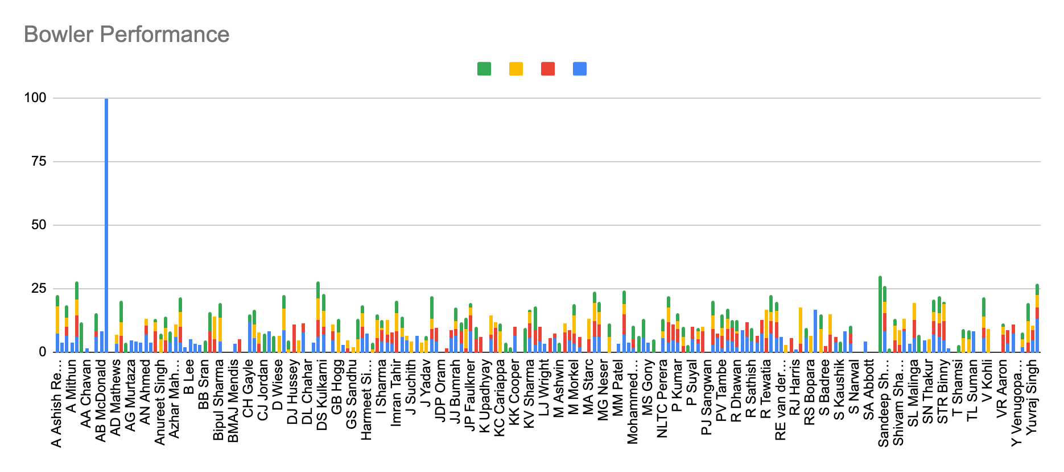
Player Consistency Analysis
A Nehra, B Kumar, DR Smith, MG Johnson, RA Jadeja,Sandeep Sharma and Z Khan kept consistency in bowling

Slide 6
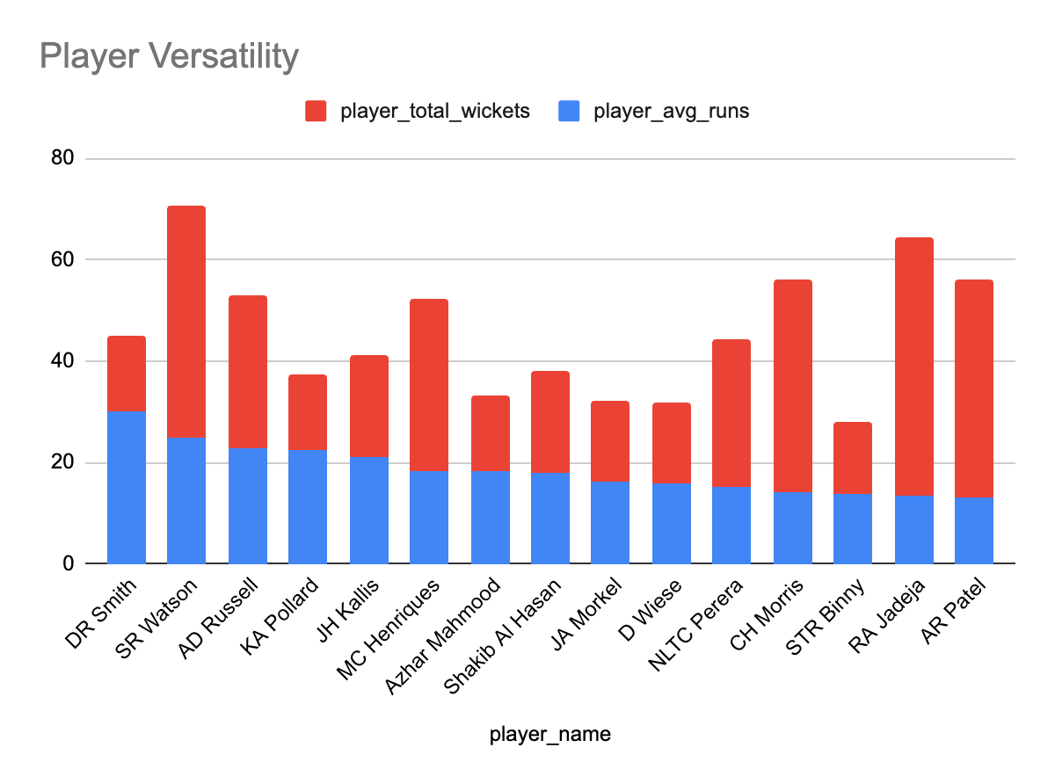
Player Versatility

Slide 7
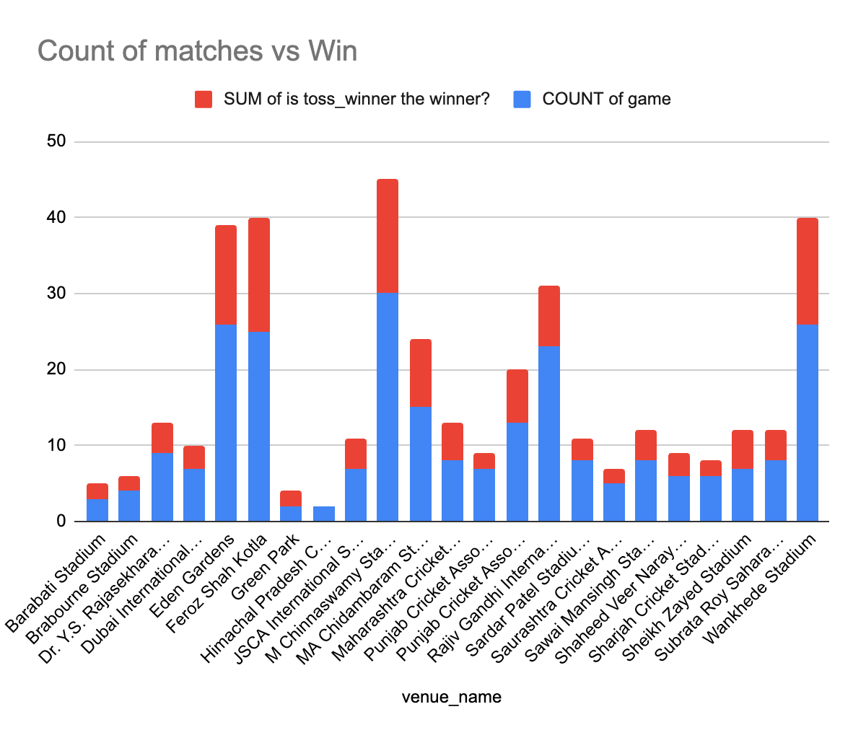
Toss Decisions
Toss decisions have no impact on the matches

Slide 8
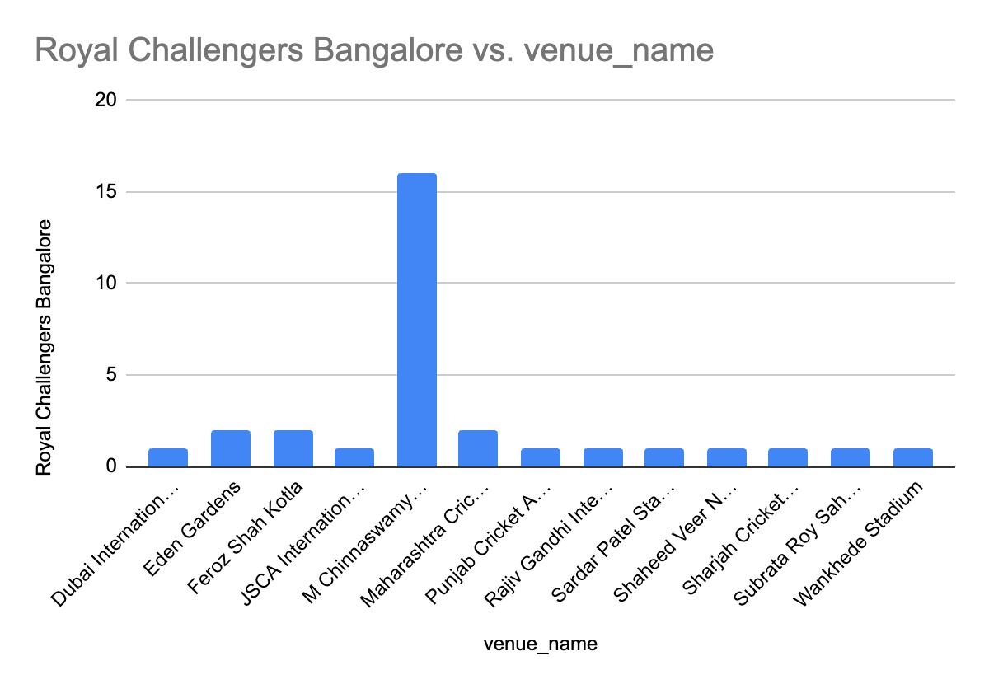
Impact of Venue
Home ground has huge impact on the performance
Strategies that are included are :
travel 1 week prior to the match to get accommodated with the match location.
Practice in different grounds/pitches

Slide 9

Strategic Recommendations
Factors contributing to the high-scoring matches:
Aggressive training and mental preparations to adapt all conditions
Proper understanding about the pitch
Understanding about the opponents - their strength and weakness

Slide 10
Strategic Recommendations
Parameters that should be focused on while selecting the players
Are they all-rounder? Consider players who are efficient in both batting and bowling
Past performances - top performers of the team
Age and Past Injuries

Slide 11

Conclusion
Identified top performers
Analysed rcb’s past performances
Found strategies

Slide 12
Reference
IPL data

